Slide 1
Superior Colliculus

Slide 2
Superior Colliculus
Mostly direction selectivity and ipsilateral connectivity.
In shrews, neither are really present.
Surround suppression.
Cats and macaques- neurons not orientation selective- Cynader and Berman 1971

Slide 3
Casagrande et al 1972 Science
Superior colliculus in tree shrew-
Superficial – form discrimination- anterograde projections to visual thalamus- receives input from retina and V1, projects to pulvinar, pretectum and dLGN & vLGN
Deeper- object tracking and orienting behaviour- anterograde projections to non-visual thalamus and brainstem nuclei.

Slide 4
Segregation into superficial and deeper layers also shown in:
Anterograde Degeneration Study of the Superior Colliculus in Tupaia glis: Evidence for a Subdivision betn superficial and Deep layers.
A pathway through pulvinar to extrastriate areas that allow form-perception to be preserved.

Slide 5
Lane et al 1971
Full retinotopic map of visual field found on the contralateral superior colliculus.

Slide 6
Albano, Humphrey and Norton, 1978; Journal of Neurophysiology
Looked at what cell types are in different layers of superior colliculus.
Used stationary and moving spots and bars.
Show orientation selectivity in a class of cells EF cells.
Also demonstrate surround suppression.

Slide 7
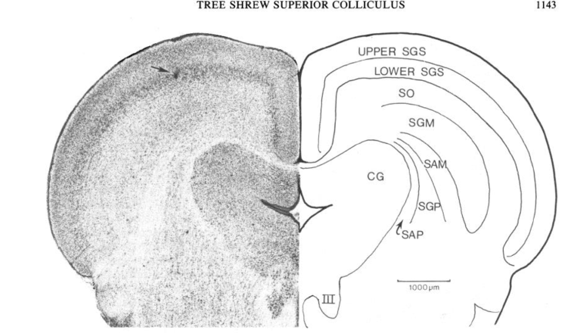
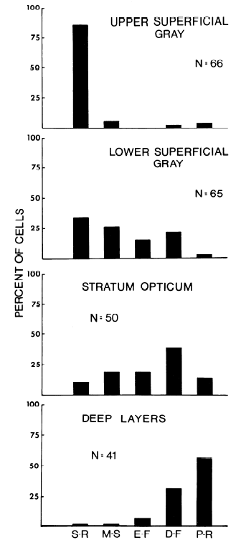
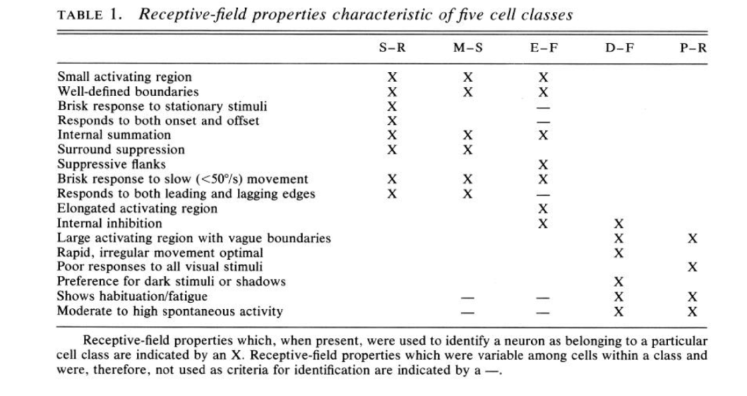
Albano, Humphrey and Norton, 1978; Journal of Neurophysiology

Slide 8
Albano, Norton and Hall, 1979, Brain Research
Further segregation of SGS- upper SGS= small cells, dendritic fields that are parallel and perpendicular to the pial surface. Projects to dLGN.
Lower SGS- larger RFs, horizontal dendritic fields. Projects to pulvinar.
Notes:
We probably recorded from lower SGS?

Slide 9
What we have done?
Did not particularly look at the lamina of the neurons.
Also what we have does not really compare well with Albano’s responses...
Where were we even recording from?

